Slide 1


Slide 2


Internet

Slide 3


What is internet ?
Internet can be defined as a huge collection of computers interconnected to each other across the world.
It is a great place to find information which is available through different websites.

Slide 4


What is a website?
A website is a collection of related information stored in different pages.
Every website has an address.
We can visit website by typing address in the web browser.

Slide 5





What is web broswer?
A software application used to access information on the World Wide Web is called a web browser.
“Worldwide Web” was the first web browser created by Tim Berners Lee in 1990. This is completely different from the World Wide Web we use today
There are many web browsers such as internet explorer, chrome, Mozilla, etc
For more information visit:- https://byjus.com/govt-exams/web-browser/

Slide 6
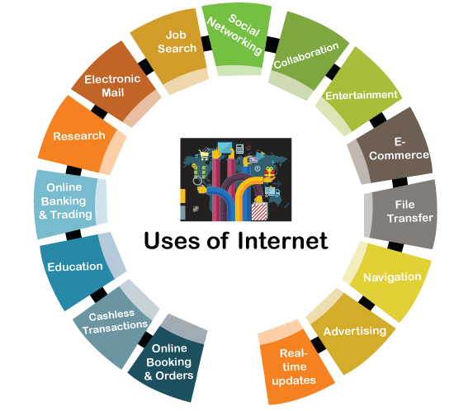
Uses of internet
For searching information.
In communication.
For shopping.
For entrainment.
In education.
For online ticket booking.

Slide 7
Connecting to others using internet
There are different ways through which we can communicate through internet depending on our requirement.

Slide 8




CONNECTING TO OTHERS WITH INTERNET
E-Mail
Instant messaging
It stands for electronic mail. It is used to send and recive messages in electronic form. Some commonly used email website are gmail.com, rediffmail.com, yahoo.com
Instant messaging used for online chat. One can send and recevie an immediate response . Apps like whatsapp, viber, allo are used for instant messaging.
Video conferencing
Social networking websites
Video conferencing is a face to face communication among people sitting at different locations connected through each other through internet.
These websites help you to connect to your friends, relavtives online and share information, images, ideas, etc. Some social networkings sites are facebook, instagram, twitter, etc

Slide 9
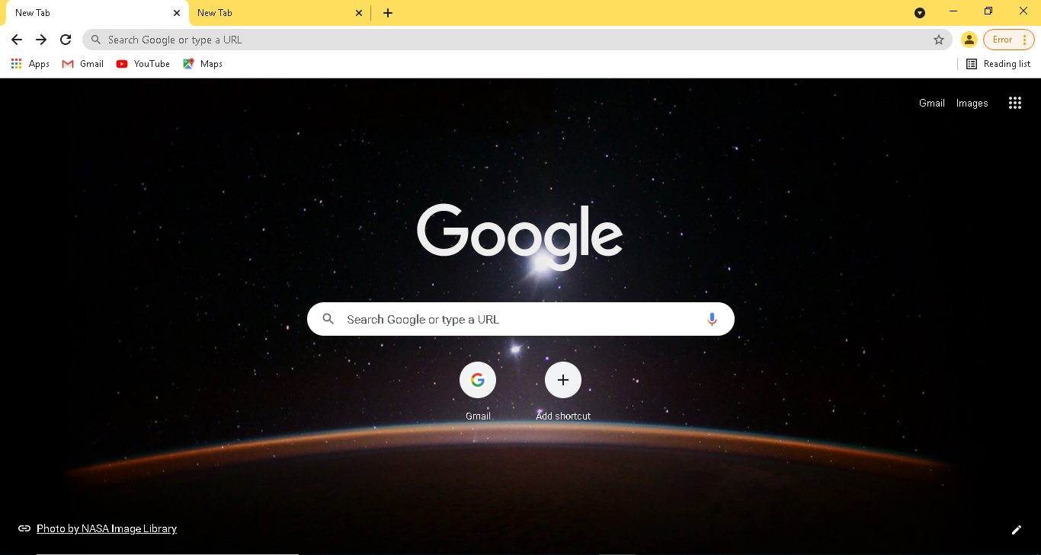
Refresh button
Close button
Forward and backward
URL /Search bar
Shortcuts

Slide 10

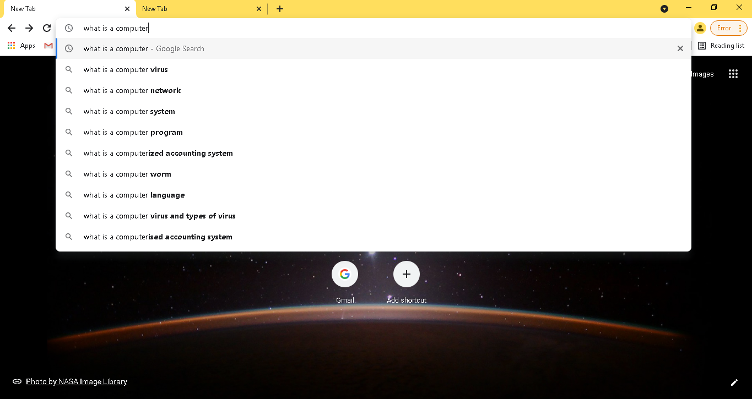
How to search information on chrome?
Open chrome.
Type whatever you want to search in search box or url and press enter key.

Slide 11
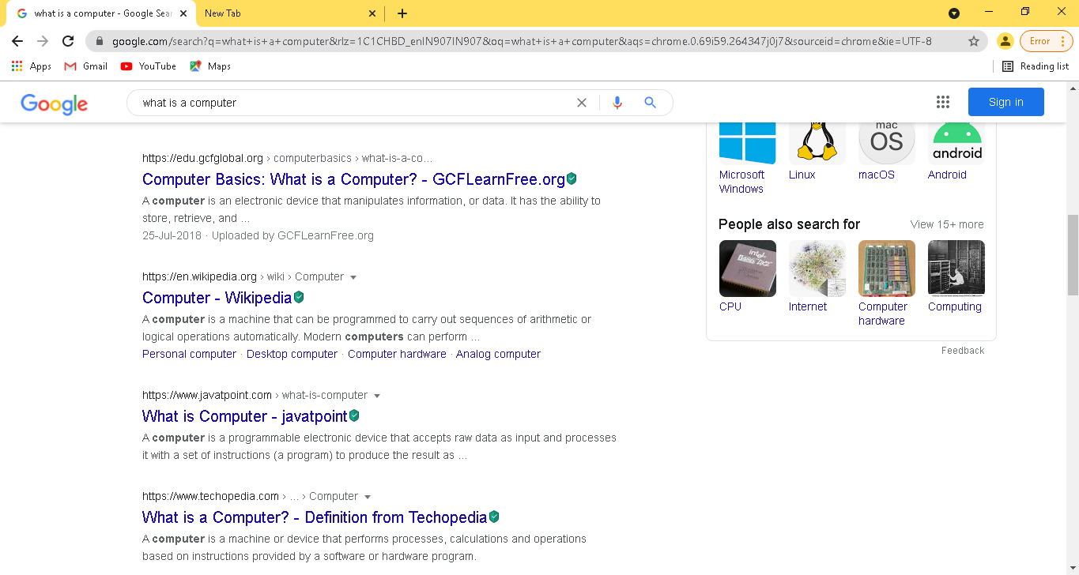
Different search result will appear.
Click on any of the link to see what information it contains.

Slide 12


